Slide 1
Discrete Event Simulation

Slide 2
Terminology
Will simulate stochastic dynamic discrete-event systems.
  Stochastic – randomness/unpredictability over time.
    # of customer arrivals.
    Service/process times.
    Equipment failures.
    Scrap/inspections,…
  Dynamic – the system changes over time. The passage of time is part of the simulation.
    Simulation of a production shift.
    Simulation of a service facility from 9-5, …

Slide 3
Terminology
Discrete event – The system state changes only when specific events occur and these events only occur at discrete time instances.
  System state – Usually a vector of information with the necessary information to describe a system for analysis purposes.
  Examples
    Number of jobs at each machine, machine status.
      [(n₁,s₁),(n₂,s₂),…,(n_{m},s_{m})]

Slide 4
Discrete Event Simulation
Discrete Event Simulation
System parameters
Representation of a dynamic stochastic system on a computer.
Random outputs
Controls for experimentation
Analysis of experimental output

Slide 5
Discrete Event Simulation
To understand how and why we simulate such systems we will cover:
  Analysis options.
  Performance measures.
  The mechanics of how a simulation is implemented on a computer.
    Fundamental components/terminology.
    Manual execution of a simulation.
  Modeling views/orientations.
  Representing randomness.
  Analyzing input and output data.
  The steps of a simulation study.

Slide 6
Analysis Options
What are the objectives of the analysis?
What variables and controls are being changed and analyzed?
What is the design stage and how much precision is needed?

Slide 7
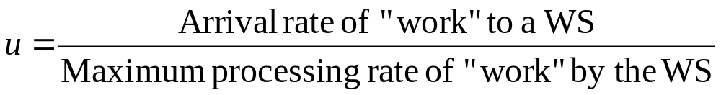
Analysis Options
Early design stage, focus is on resource utilizations and WIP (jobs waiting for service – “large amount”?).
  Can often calculate resource utilizations and assess WIP from the results.

Slide 8
Example
A workstation has two machines in parallel that can process jobs at a rate of 15 JPH. Jobs arrive over time at a rate of 25 JPH.

Slide 9
Analysis Options
Unless a system has very high relative variability, utilizations < 90% will lead to “reasonable” queue sizes.

Slide 10
In-class Exercise
Two types of jobs (A and B) arrive to a single machine for processing. The arrival rate of type A jobs is 5 per hour, and 2.5 per hour for type B jobs. Type A jobs have an average service time of 5 minutes, and type B jobs have an average service time of 11 minutes.
  What is the utilization of the machine?

Slide 11
Analysis Options
At the next level of detail queuing models may be applied.
  More information than utilization calculations.
  Difficult skill to apply.

Slide 12
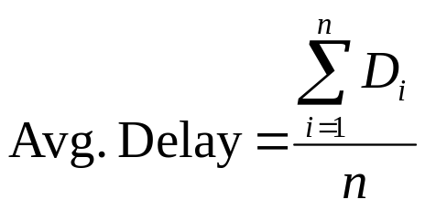
“Simulation Performance Measures”
By simulation performance measures we mean the different categories of performance measures based on simulation data that must be collected to compute the measures.
Simulation performance measures.
  Tally statistics –”Tally” is an Arena term.
    Data is collected on a measure with individual outcomes.
    Example – Let D_{i} = Delay in queue for customer i.

Slide 13
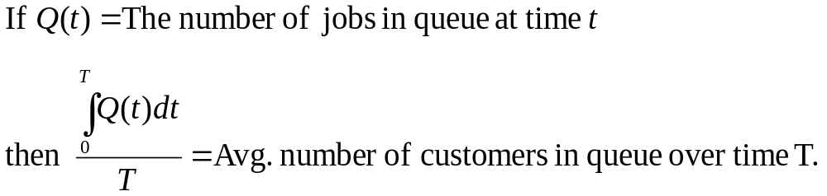
“Simulation Performance Measures”
Simulation performance measures.
  Counters – Incremented when specific events occur.
    E.g., Completed jobs.
  Time average measures – Arena calls these “Time persistent”
    Variables are weighted by the length of time they occur.
    Example – The average number of jobs in queue.

Slide 14
“Simulation Performance Measures”
Simulation performance measures.
  Maximums and minimums – Changed when specific comparisons indicate.
    E.g., Maximum jobs in queue.

Slide 15
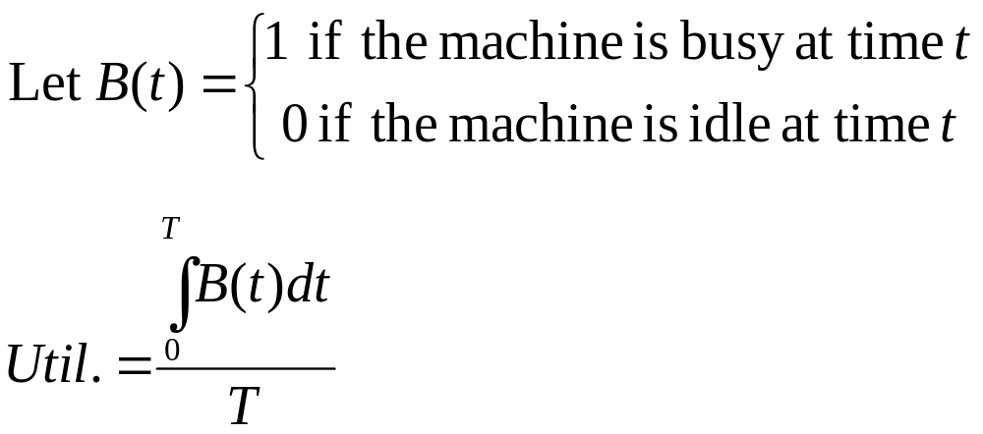
“Simulation Performance Measures”
The average time a part spends in the system.
  Tally or Time average?
Utilization of a machine.
  Tally or Time average?

Slide 16
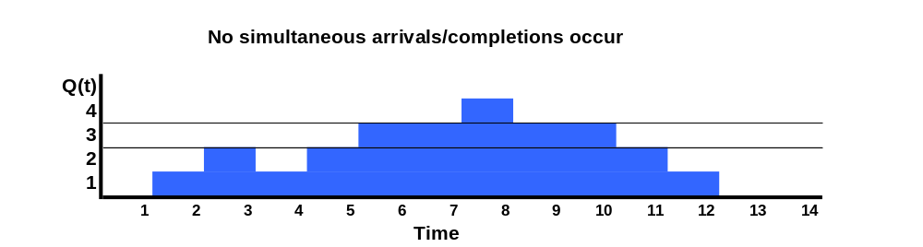
In-class Exercise
Compute the average number in system, and average time in system through T = 14 (assume first-in-first-out).
N(t)

Slide 17
In-class Exercise

Slide 18
Mechanics of Simulation
Terminology
  Entities – Objects that move through the simulated system.
    Examples
      Jobs
      Customers
      Entities used for modeling.
    Entities can be combined and split.
  Attributes – Parameters, data specific to an entity.
    Examples
      Job type
      Processing time
    The same concept as objects (entities) and object data (attributes) in Object Oriented Programming

Slide 19
Mechanics of Simulation
Terminology
  Global variables/parameters – System wide values accessible by all entities and resources.
    Examples
      Simulation time.
      Number of jobs in system.
  Resources – Items that are used by entities and found in limited amounts.
  Queues – Spaces where entities wait for resources.

Slide 20
Mechanics of Simulation
Terminology
  Events – Actions that cause the system state to change.
    Examples
      Job completion.
      Job arrival.
      Failure.

Slide 21
Mechanics of Simulation
Event calendar and the passage of simulated time.
  Simulations maintain an event calendar that functions like the control center of the simulation.
  The event calendar is a time sorted list of events and the times that they occur.
  When the event at the top of the list occurs, simulated time is advanced and specific logic is initiated.
    This logic changes the state, updates statistics, and schedules additional events.

Slide 22
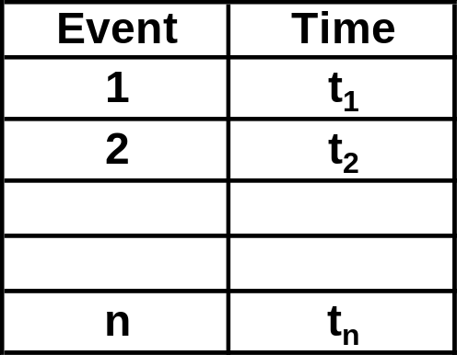
Event Calendar
Main
Procedures/
Functions

Slide 23
Simulation Clock
Simulation time does not advance uniformly unless controlled.
x
x
x
x
x
x

Slide 24
Manual Simulation
We will execute a manual simulation on paper to understand the fundamentals of simulation mechanics.
You will execute what the computer carries out in a simulation.

Slide 25
Example System
Arena model 03-01 – A “single server queuing system with infinite queue size”.
System description
  Parts (jobs) arrive one at a time to be processed at a single machine (drilling) that can hold and work on a single job at a time. If the machine is idle when a job arrives it immediately starts processing, otherwise the job waits in an infinite capacity queue and is served in first-in-first-out (FIFO) order. The machine is assumed to never go down.

Slide 26
Manual Simulation
Will use pseudo code and a table to implement the simulation.

Slide 27
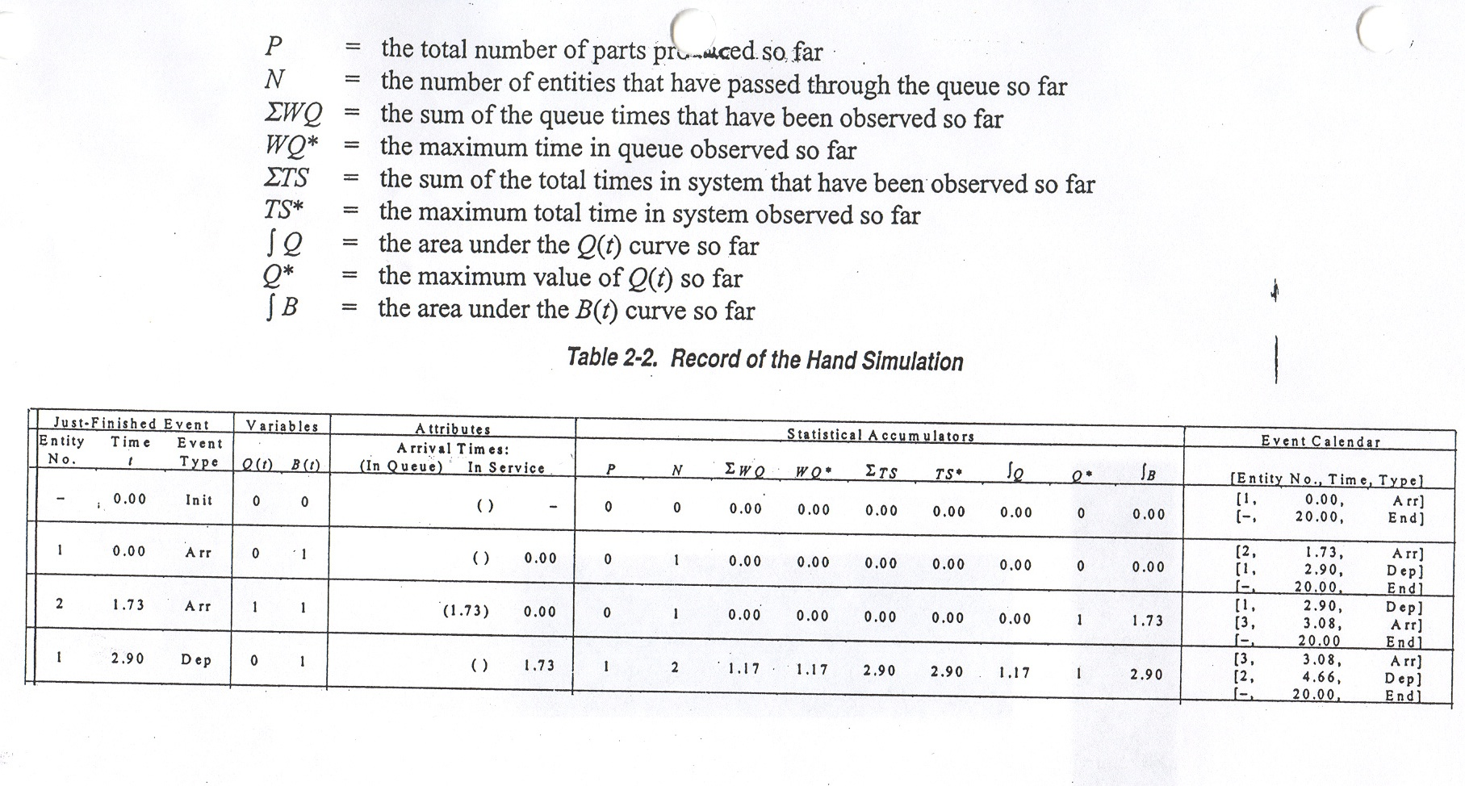
Manual Simulation Table

Slide 28
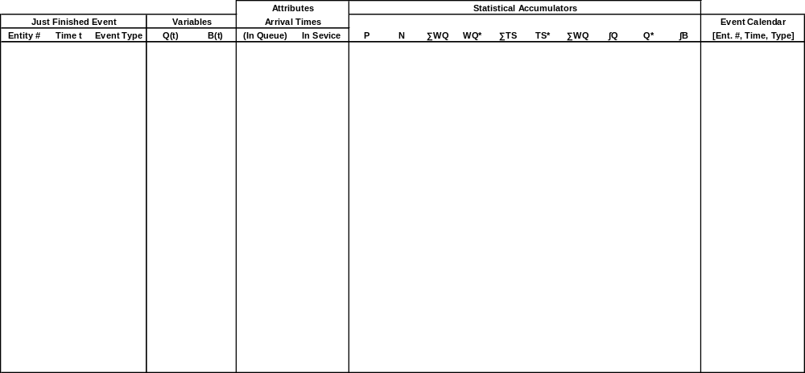

Slide 29
Simulation Modeling Views
The manual simulation looked at the system dynamics by examining the events that occur.
  This is called event orientation.
Event orientation
  Define the system state.
  Identify all events that change the state of the system.
  Code logic that simulates the dynamics caused bythe occurrence of events.

Slide 30
Simulation Modeling Views
Process orientation – The focus on defining the system dynamics is on entities and how they flow through the system.
Manual simulation.
  Arrive-> Queue -> Machine -> Depart
Arena is process orientated simulation system.
Process orientation tends to be easier when modeling large systems.
Most simulations are implemented in an event driven manner (including Arena).

Slide 31
Initial Steps in a Simulation Study
Define the objectives of the study.
  Why is simulation needed?
  What performance measures will be used?
Write a description of the system.
  Verbal.
  Draw a flow chart of the system.
List assumptions if any.
Write a report introduction.
From the system description identify
  Data collection needs
    Random variables – E.g., Operation times.
    Parameters – E.g., Business hours.

Slide 32
Intermediate Steps
Begin model development.
  Lab sessions with Arena.
  Random variate generation.
Fit distributions to data for use in the model.
  Input analysis.
Verify and validate the model.
Experimentation and analysis.
  Statistical analysis of output.
  DOE.
  Variance reduction.
  Optimization.

Slide 33
Final Steps
Report writing.
Presentations.
  Animation if necessary
Other points.
  On going communication throughput the study.
  Observation/face time.

